Slide 1
Operating System Security
Data Recovery using Hiren’s BootCD PE

Slide 2

Group 2 Members
STUDENT NAME | STUDENT NUMBER
James Soko | 20231392
Astone Mwamba | 20231951
Ben Zulu | 20231886
Alinet Hangoba | 20231685
Namusokwe Naomi | 20230443
Albert Mulenga | 20230427
Albertna Mwewa | 20231875
Rabby Chongo | 20231350
Alinuswe Simbeye | 20231271
Cindy Ngandalo | 22175202
Boyd Phiri Jr. | 20231939
Obed Mwape | 20231799
Carestone Mupaile | 20231899
Nelson Kapinga | 20231839
Gabriel Hichintu | 20231919
Violet Kikumbaila | 20231791

Slide 3
QUESTION
Recover a music file deleted from any memory stick using Hiren’s BootCD PE.

Slide 4
Introduction
In the world of modern computing, data loss can be catastrophic.
A simple deletion, whether accidental or intentional, can seem like the end of a file.
However, with the right tools and knowledge, files can be recovered.
In this presentation, we will demonstrate how to recover a deleted music file using Hiren’s BootCD PE.

Slide 5
Objectives
To demonstrate the recovery of a deleted music file using Hiren’s BootCD PE (Recuva).
To understand the file recovery process within an operating system environment.
To explore the capabilities of Hiren’s BootCD PE in data restoration and OS security.
To emphasize the role of data recovery tools in mitigating data loss risks.

Slide 6
Hiren’s BootCD PE
Download Hiren’s BootCD PE
Hiren's Boot CD is an all-in-one bootable rescue disc solution that contains a load of useful Windows repair tools you'll want to have when you can no longer boot into your PC.
Imagine issues like hard drive failure, virus infections, partitioning, password recovery, and data recovery.
Source → Make use of (website)

Slide 7
Data Recovery
Data recovery is the process of retrieving lost, deleted, damaged, or inaccessible data from storage devices, often involving specialized software and techniques to scan, identify, and restore the data.
In digital forensics, a wide array of data can be recovered, including deleted files, emails, browsing history, metadata, and even data from encrypted or damaged devices.
Our focus in on deleted files (music).

Slide 8
How to Recover Deleted Files Using Hiren’s BootCD PE

Slide 9
Creating a Bootable Device
If you’ve downloaded Hiren’s BootCD PE from the actual web, the file will be written as .iso
Use a booting tool such as Rufus or PowerISO to make the .iso file bootable into your USB drive.
OR
If you have the Hiren’s BootCD PE as a folder, copy the files into an USB drive and you are ready to go.

Slide 10
Initializing and Loading Up Hiren’s BootCD PE
Shutdown and restart your PC into the Boot menu by pressing F12 repeatedly depending on your manufacturer.
Select the bootable USB drive e.g., UEFI: VendorCoProductCode 2.00, Partition 1
Wait for Hiren’s BootCD PE to initialize and load up.

Slide 11
Data Recover With Hirens BootCD PE
Steps
Tools
Navigate to the folder called Utilities (Located on the Desktop)
Navigate to the folder called Hard Disk Tools
Navigate to the folder called Data Recovery
AppleFS for Windows
Check Disk GUI
DME
Lazesoft Data Recovery
Linux Reader
PhotoRec
Puran Data Recovery
ReclaimMe Free RAID Recovery
Recuva
Unstoppable Copier
Victoria

Slide 12
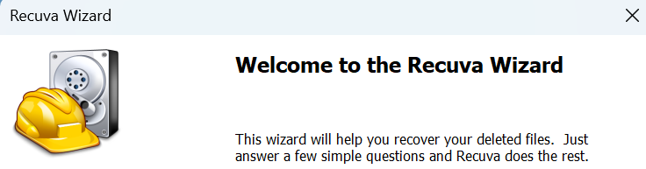
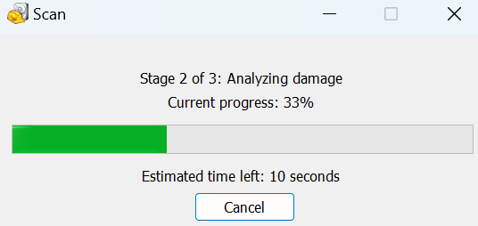

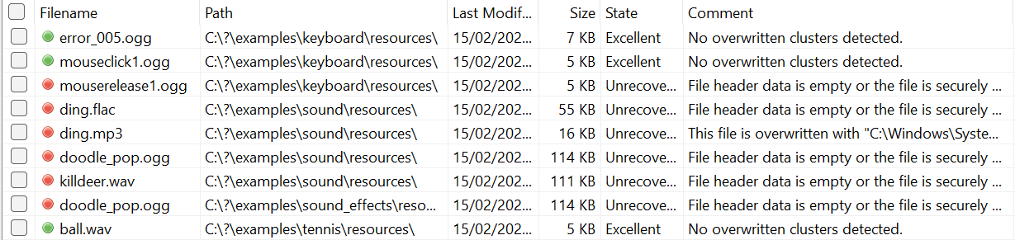

Recuva
Open Recuva
Select the File Type
Select the File Location
Start the Scan
Switch to Advanced Mode

Slide 13
The Role of Data Recovery Tools in Mitigating Data Loss Risks
File Recovery – They provide the ability to recover lost data from various storage mediums, ensuring important files are not permanently lost due to accidental deletion or system failures.
Minimizing Downtime – These tools enable quick restoration of data, reducing downtime and maintaining business continuity in both personal and professional environments.
Data Persistence – By recovering seemingly unrecoverable files, data recovery tools highlight the importance of data persistence and ensure that critical information is safeguarded.

Slide 14
Let’s Jump Into the Practical
End of The Theory Presentation

